Slide 1
Crop Prediction Based on Soil Health Parameters using Machine Learning Techniques
Meity Project

Slide 2
CONTENTS
Introduction
Soil Health
Soil Health Parameters
Data Set Collection
Analyzing the Data
Data Wrangling
Exploratory Data Analysis
Clustering Analysis
Predictive Analysis
Accuracy Check
Deployment of Model on EC2 Server
Results
Conclusion

Slide 3
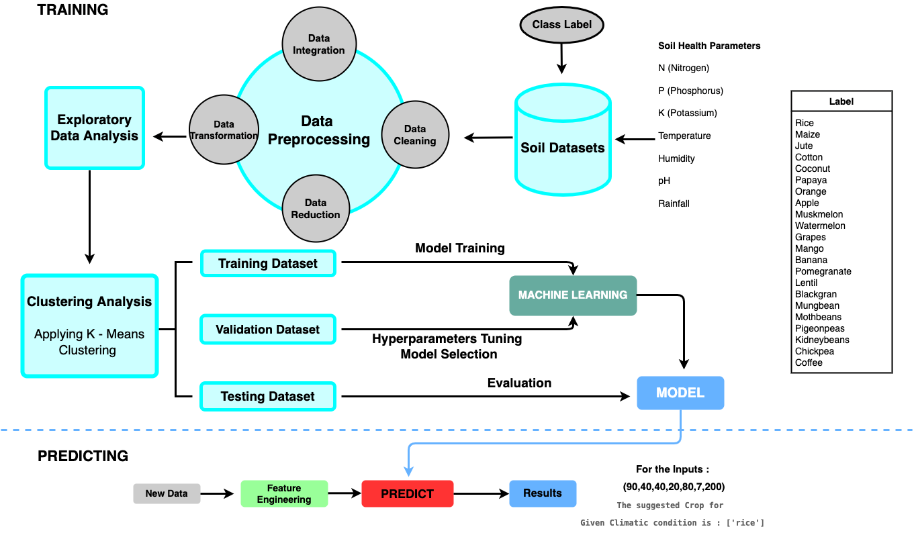
PROPOSED ARCHITECTURE

Slide 4
INTRODUCTION
In general, agriculture is the backbone of India and also plays an important role in Indian economy by providing a certain percentage of domestic product to ensure the food security.
But now-a-days, food production and prediction is getting depleted due to unnatural climatic changes, which will adversely affect the economy of farmers by getting a poor yield and also help the farmers to remain less familiar in forecasting the future crops.
This project work helps the beginner farmer in such a way to guide them for sowing the reasonable crops by deploying machine learning, one of the advanced technologies in crop prediction.
A web-based platform has been developed and deployed on the AWS server. The users are encouraged to enter parameters like N, P, K, Temperature, Humidity, pH, and rainfall will be taken automatically in this application in order to start the prediction process.

Slide 5
SOIL HEALTH
Soil health, also referred to as soil quality, is defined as the continued capacity of soil to function as a vital living ecosystem that sustains plants, animals, and humans.
Soil…
Covers the earth’s surface can support plant life is unconsolidated material containing water, air space, organic matter, plant roots and myriad living organisms. Parent materials, climate, related organisms. Relief act together through time space to produce a continuum of different soils within the soil.
Health…
A condition in which vital functions are performed normally or properly.
Soil Functions…
Produce biomass (food, fiber, energy) Regulate water flow and storage Filter, biffer, and transform matter storehouse minerals, organic matter and myriad organisms. Supports for plants and structures. Provide raw materials(sand, silt and clay) Provide clues to past climates, vegetation, ecology and civilizations.

Slide 6
SOIL HEALTH PARAMETERS
Soil Health Testing involves identifying indicators of soil functions that can be measured.
Chemical Parameters : The chemical parameters of soil are the levels and availability of nutritional minerals elements for the plants and the chemical parameters of soil in connection with there restoration or availability.
Physical Parameters : The physical parameters of soil include texture, structure, porosity, density, consistence, aggregate stability, and temperature.
Land Use Parameters : Th Land Use Parameters help devices strategies for monitoring microbial diversity and soil functioning for end users and policy makers.
Soil Color Parameters : The Soil Color is influenced by it’s minerals composition as well as water and organic contents.

Slide 7
DATA SET COLLECTION
Data is composed from a different source and optimized for data sets. And the data is used to evaluate descriptively.
Several abstract online outlets, like Kaggle, Google weather forestation and data government, provide the data for up to 10 years in series.
The data sets such as soil nature, climatic conditions and seed data are used for the crop prediction and better crop yields.
For this particular project the data set has been collected from Kaggle which consists of more than two thousands row of data having different attributes such has N, P, K, temperature, humidity, pH, rainfall, label.

Slide 8
ANALYZING THE DATA
Analyzing the data is considered as a significant step machine learning phase.
Data Analysis is the process of systematically applying statistical and/or logical techniques to describe and illustrate, condense and recap, and evaluate data. According to Shamoo and Resnik (2003) various analytic procedures “provide a way of drawing inductive inferences from data and distinguishing the signal (the phenomenon of interest) from the noise (statistical fluctuations) present in the data”..
An essential component of ensuring data integrity is the accurate and appropriate analysis of research findings. Improper statistical analyses distort scientific findings, mislead casual readers (Shepard, 2002), and may negatively influence the public perception of research. Integrity issues are just as relevant to analysis of non-statistical data as well.

Slide 9
DATA WRANGLING
Data wrangling is the process of cleaning and unifying messy and complex data sets for easy access and analysis.
With the amount of data and data sources rapidly growing and expanding, it is getting increasingly essential for large amounts of available data to be organized for analysis. This process typically includes manually converting and mapping data from one raw form into another format to allow for more convenient consumption and organization of the data.
Goals of Data Wrangling
Reveal a “deeper intelligence” by gathering data from multiple sources.
Provide accurate, actionable data on the hands of business analysis in a timely matter
Reduce the time spent collecting and organizing unruly data before it can be utilized
Enable data scientists and analysts to focus on the analysis of data, rather than the wrangling.
Derive better decision-making skills leaders in an organization.

Slide 10
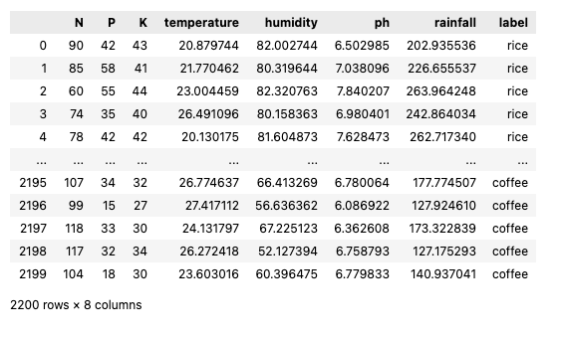
EXPLORATORY DATA ANALYSIS

Slide 11
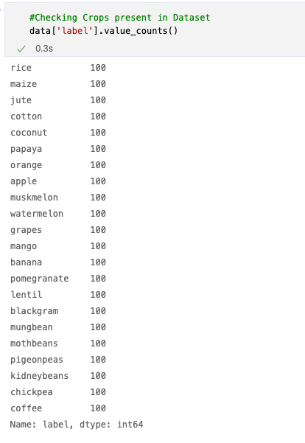
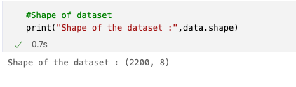
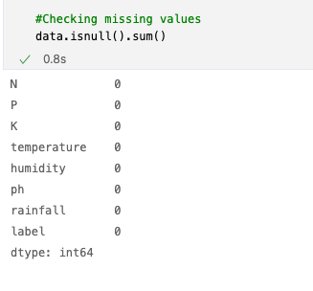
EXPLORATORY DATA ANALYSIS

Slide 12
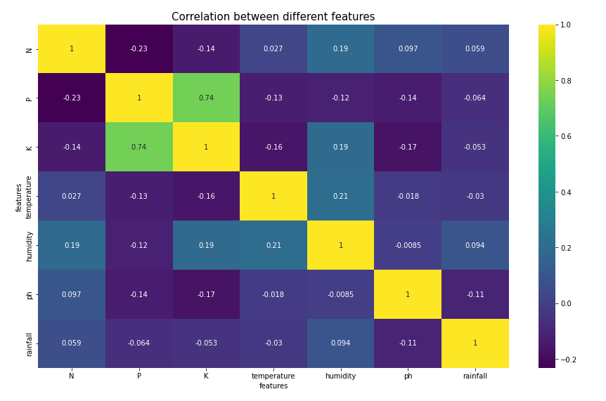
EXPLORATORY DATA ANALYSIS

Slide 13
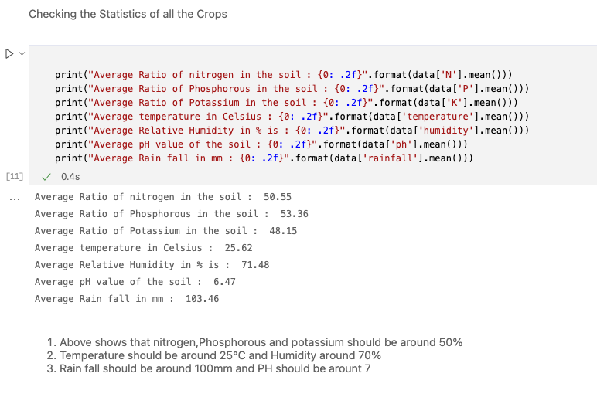
EXPLORATORY DATA ANALYSIS

Slide 14
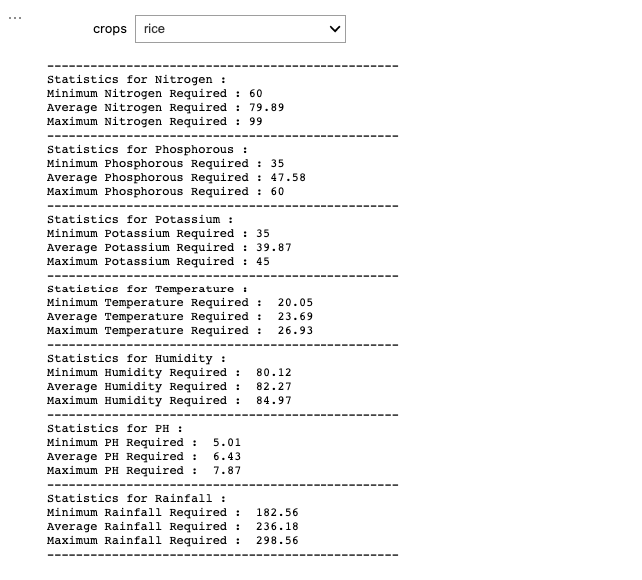
EXPLORATORY DATA ANALYSIS
Checking the Statistics For Each Crops :
We can find statistics of any other crop by selecting on drop down list.

Slide 15
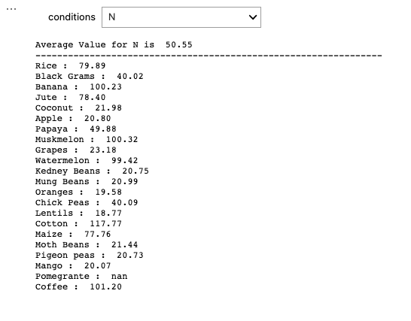
EXPLORATORY DATA ANALYSIS
Average requirements For Each Crops With Average Conditions :
We can find rainfall, temperature, humidity, Nitrogen, Phosphorus and pH value of every individual crop by selecting on the drop down menu.

Slide 16
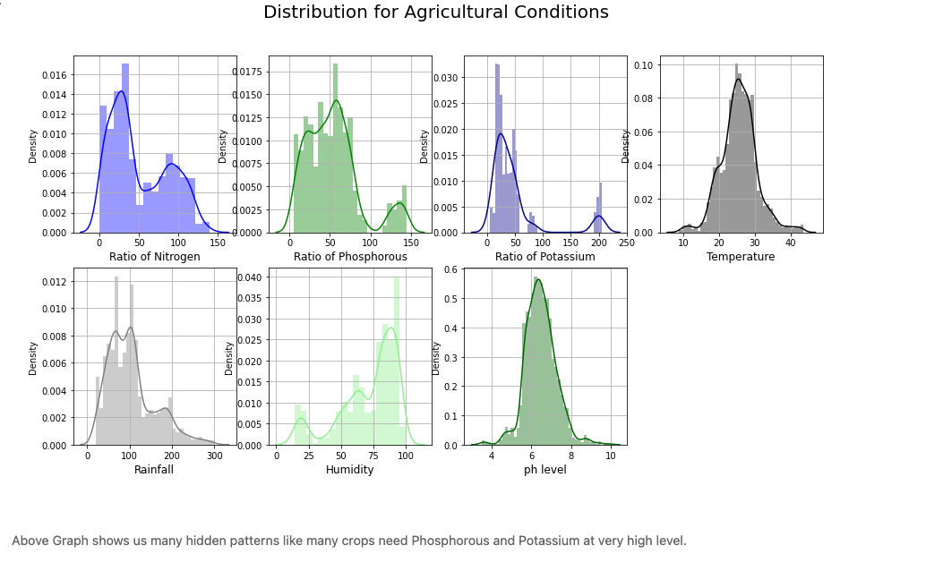
EXPLORATORY DATA ANALYSIS

Slide 17
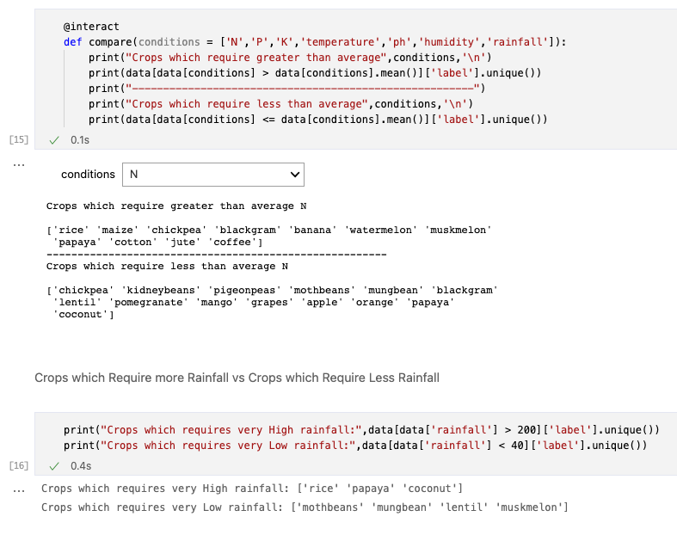
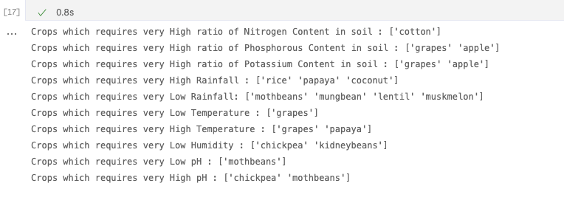
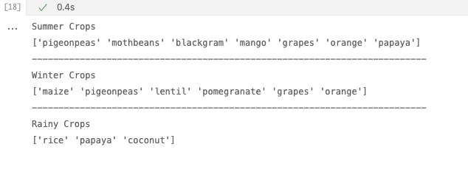
EXPLORATORY DATA ANALYSIS : HIDDEN PATTERNS
Crops requires more Rainfall, Temperature, Humidity, Nitrogen, Potassium, Phosphorus and ph value VS Crops requires Less.

Slide 18
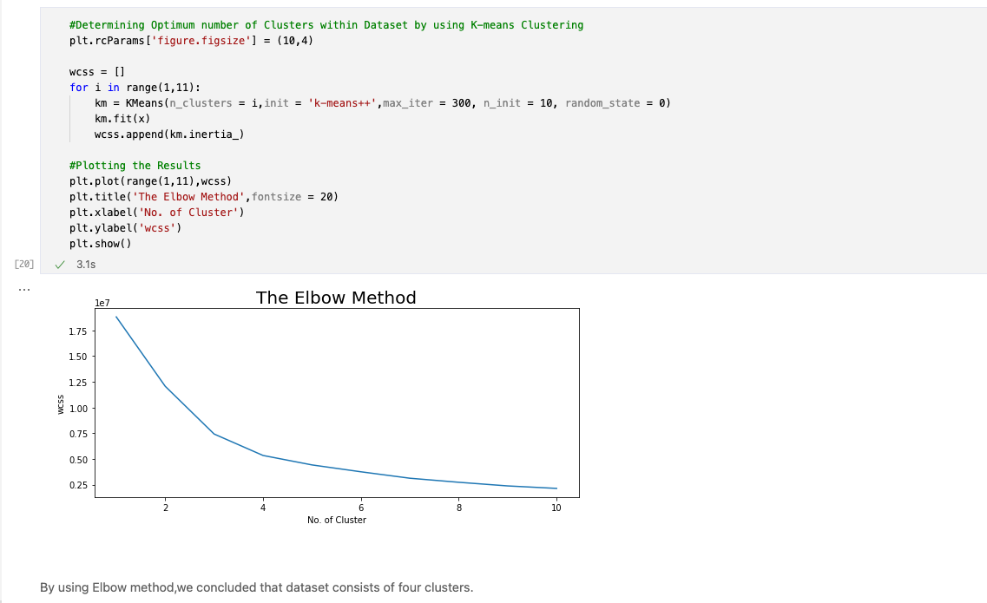
CLUSTERING ANALYSIS

Slide 19
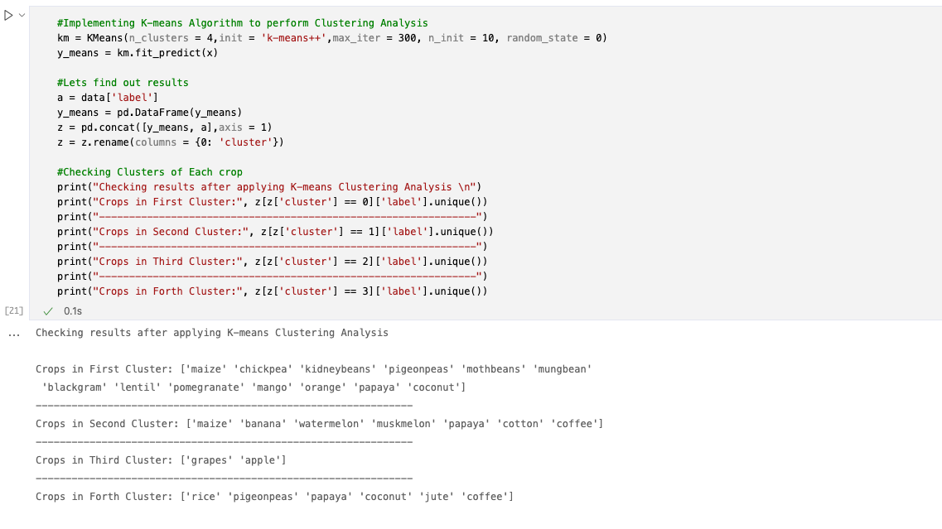
CLUSTERING ANALYSIS

Slide 20
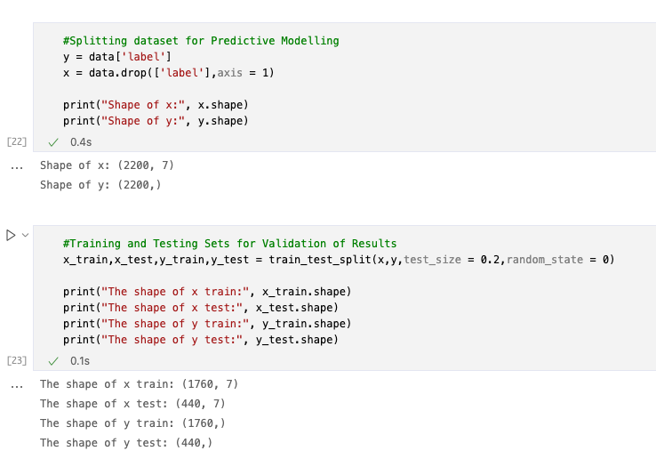
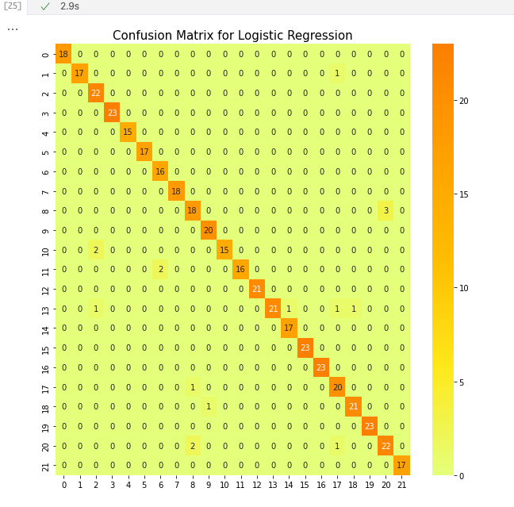
PREDICTIVE ANALYSIS

Slide 21
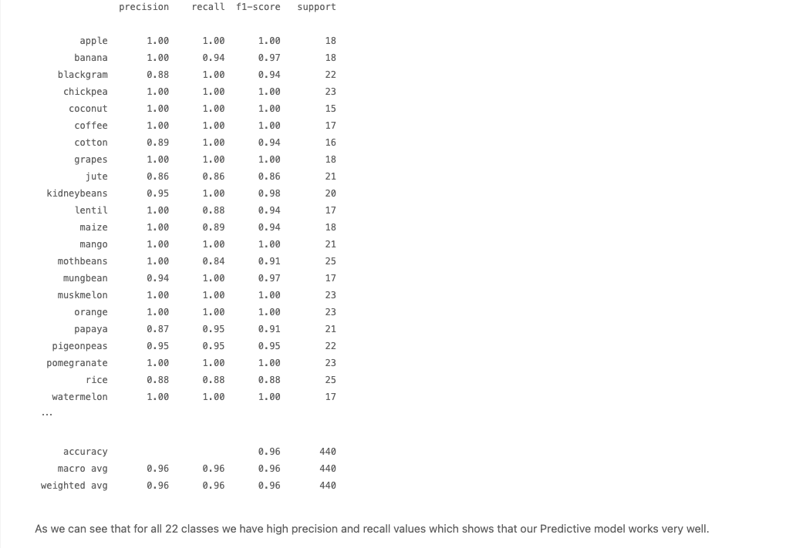
ACCURACY CHECK

Slide 22
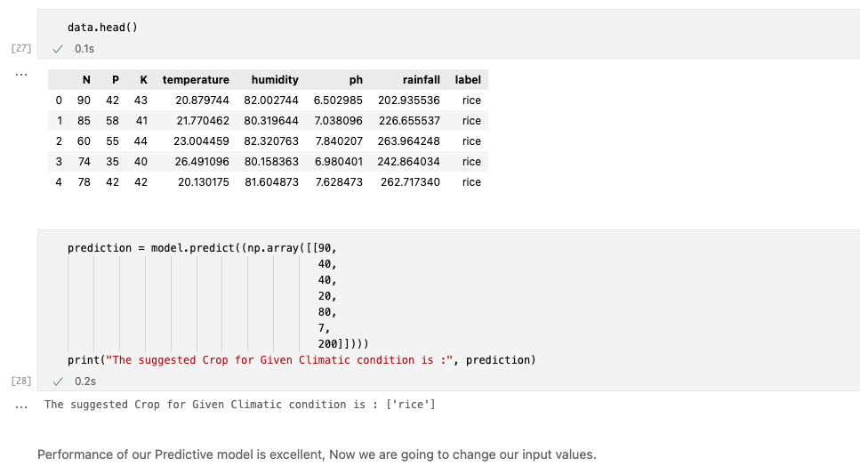
OUR MODEL IS READY, N WE CAN USE MODEL TO PREDICT CROP NAME

Slide 23
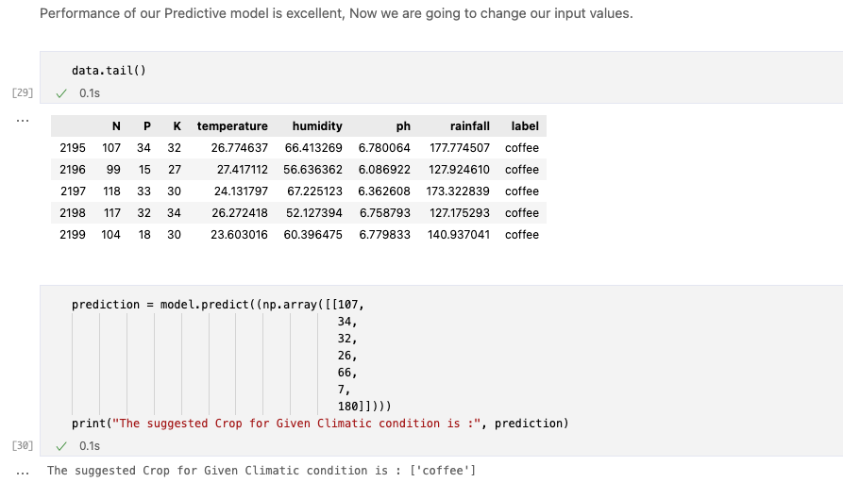
OUR MODEL IS READY, NOW WE CAN USE MODEL TO PREDICT CROP NAME

Slide 24
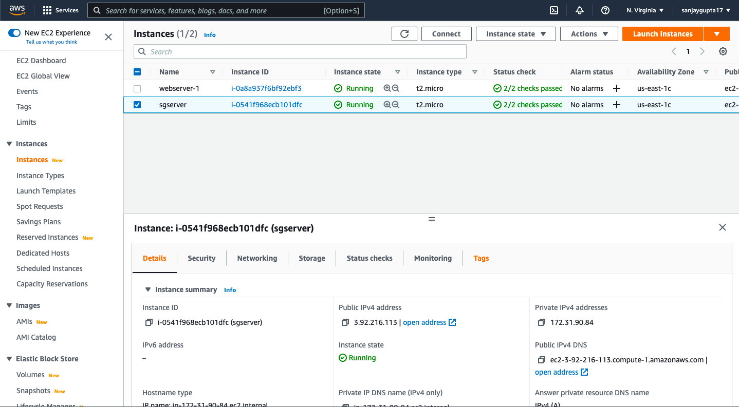
DEPLOYMENT OF MODEL ON EC2 SERVER

Slide 25
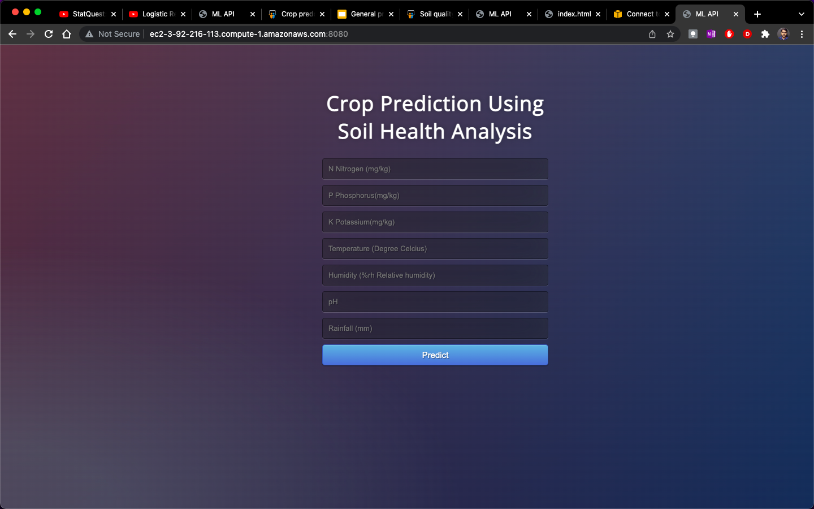
MODEL WEBSITE

Slide 26
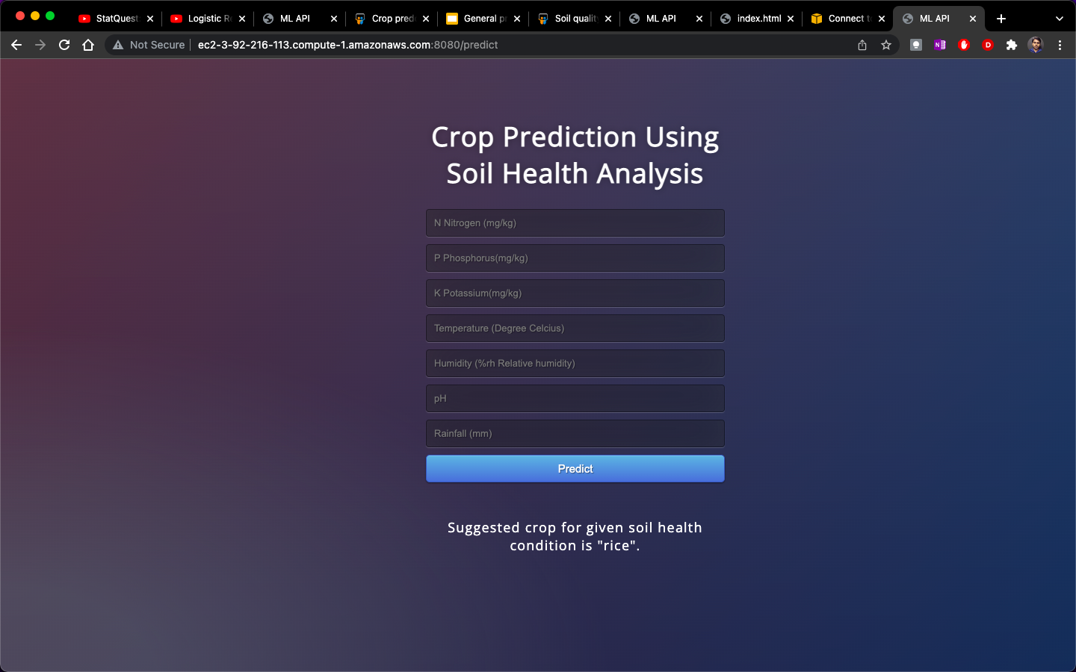
RESULTS

Slide 27

CONCLUSION
The proposed supervised machine learning using Logistic Regression algorithm is developed to predict the crop at high accuracy. Thus, the crop is predicted as an output for the given input parameter.
This work may greatly help the needy farmers who have less knowledge in predicting the crops for developing a sustainable future.
In future it may also extend to suggest the fertilizer, suitable guidelines for cropland and crops for the given input. In addition, source of sunlight and crop health are monitored at regular intervals and it is also taken into the account for achieving a better crop yield.

Slide 28

Thanks!

